Slide 1


Slide 2

Human Resource Management (HRM) concerns recruitment and selection, compensation, training and development, and employee relations. The problem facing each firm is to decide on the optimal amount of each of these HRM practices.
Which level of training or recruitment/ selection is best for the firm?
An HRM practice such as employee recruitment or training is considered a form of factor input in the production process, like capital or labor.

Slide 3
Now the production function can be written as
Q=f (K, L, HRMi)
Where,
HRMi = the amount of ith form of HRM practice
[e.g. HRMa=recruitment, HRMb= training] devoted to producing this period’s output, Q.
The goal of the firm is to maximize profit. It follows that additional units of each HRM practice should be devoted to production as long as the extra revenue generated is greater than or equal to the extra cost.
MRPHRM= MPHRMx MR= MPHRMx P

Slide 4
It is assume that the firm can produce or buy additional units of the HRM practice at a constant cost of V1. Hence profit-maximizing condition-
V1= MPHRM x P
A technological improvement or increase in company sales and employment shifts the HRM demand curve right.

Slide 5

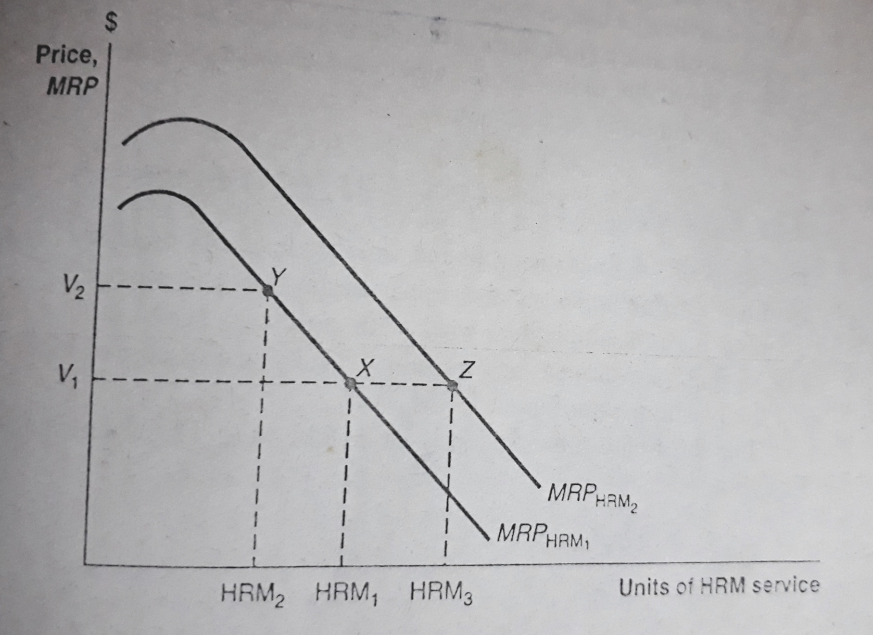

Slide 6

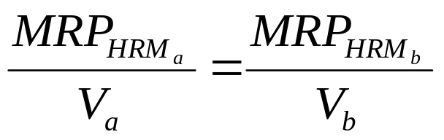
Let’s work with only two HRM inputs, HRMa (recruitment) and HRMb (training). The per unit cost of input HRMa is Va and the per unit cost of HRMb is Vb.
The profit maximizing levels of HRMa and HRMb are:
Va = HRMa
Vb =HRMb
Firms maximize profit by equating the marginal product per dollar cost of each input used in the production process. Thus, the equilibrium amount of multiple HRM inputs is given by the following equation:

Slide 7
Thus, the equilibrium amount of multiple HRM inputs are given by the following equation:
The equation states that the firm should adjust the amount of inputs HRMa and HRMb until they are equal. Thus, if an additional dollar spent on employee recruitment yields an MRP of $10 and an additional dollar spent on training yeilds an MRP of only $6, the firm would increase profit by switching more resources to employee recruitment and away from training. This process should continue until the MRP per dollar of expenditure is equal.

Slide 8

The firms follow a five-step process in performing employee selection:
Job Analysis: Discuss the content of a job and identify all the knowledge, skills and abilities [KSA] a person must posses to perform it. It also consider the attributes like leadership style, reward system and culture of the economy.
Criteria Selection: It includes the variables like quantity of output, quality of output, relations with workmates and contributions to broader organizational goals.

Slide 9
Choosing Predictors: To identify characteristics or attributes of individuals that are most closely associated with successful fulfillment of the criteria identified in step two and then devise predictors (e.g. interviews, physical exams, aptitude tests etc.) that allow the company to differentiate among job applicants according to these desired characteristics and attributes.

Slide 10
Analyzing Predictor-Criterion Relationship:
This step is to compare alternative predictors and determine which one (s) provide the most accurate information on matching up worker KSA and the criteria for successful job performance. This process called predictor validation, involves three separate aspects:
Criterion related validation: The first measures the degree to which predictor scores and criterion scores are correlated (e.g. the degree to which a high score on a physical dexterity test correlates with the number units of the good produced).

Slide 11
Analyzing Predictor-Criterion Relationship:
Content validation: The second measures the degree to which the predictor variable accurately captures the KSA needed for the job (e.g. the degree to which a physical dexterity test captures relevant job skills for a machine operator’s position).
Construct validation: The third measures the degree to which the predictor variable actually measures what it purports to (e.g. the degree to which an intelligence test really measures native intelligence).

Slide 12
Profitability and Usefulness: This step is to determine whether use of the predictor leads to greater profit for the firm. If a predictor variable satisfies the three validity tests in step four, it will help the firm achieve a better job/ person match.

Slide 13

The employee selection problem is a special case of a more general problem- optimal choice in situations of imperfect information. Imperfect information, in turn, entails both lack of information and asymmetric information.
Employee selection would be trivial if the firm could determine with zero cost and complete accuracy the future job productivity of each candidate in the application pool. But the future productivity of each worker is in fact highly uncertain. Because-
The firm lacks knowledge about all the KSA of each applicant.
Asymmetric information- the applicant know more about their own skills, abilities, and knowledge than the firm does.

Slide 14

Pay-off to Screening:
Michael Spence first illustrated the reasons why firms pay to spend resources on employee selection.
It is assumed that there are two distinct, equal-sized groups of people in the firm’s application pool:
Low ability group A people and
High ability group B people
Because individuals in group A have a lower innate ability, their MRPL for the firm will be, say, $10 per hour, while the MRPL of group B people is $20/hour.

Slide 15
Pay-off to Screening:
If the firm possessed no data on the personal characteristics of each applicant, it would randomly select a worker from the applicant pool with a probability of 0.5 of getting a person from A and B, respectively. The expected value or average level of each worker’s MRPL, therefore, would be –
0.5 ($10) + 0.5 ($20) = $15 per hour
The reason firms engage in screening is obvious from this example. At the going market wage of $15, any one firm could readily increase its profits if it could find some characteristic that distinguished a high-productivity group B from low productivity group A.

Slide 16
Pay-off to Screening:
It would reject all group A workers and hire only group B workers, paying a wage of only $15 , yet reaping a MRPL of $20.
All firms, of course, have the same incentive to engage in screening.
Each firm will attempt to identify characteristics or signals of workers that are correlated with employee performance on the job.
There is a dynamic interaction in the screening process, however, since workers, realizing that a firm is using characteristics such as years of education or veteran’s status as a signal, will attempt to acquire more of it to improve their chances of being selected.

Slide 17

The horizontal axis measures the years of education (E) obtained by the job applicant, beginning at the minimum level E0 that each person is required by law to complete (say eight years of education).
Low ability group A and High ability group B are assumed to in the applicant pool.
The goal of each firm is to use years of education as a screening device to separate both groups.
Also assume that all workers with less than E* years of education are the low-ability group A, with an MRPL of $10 per hour, while workers with E* years or more of education are high ability group B workers, with an MRPL of $20.

Slide 18
Wage (W) CA
$20 Z W(E)
$14 Y CB
$10
$7 x
0
E0 E* Years of Education (E)

Slide 19
Since, W= MRPL, the hiring standard of E* gives rise to the discontinuous wage schedule W(E). Workers with fewer than E* are presumed to be group A and are paid only $10; workers with E* or more are included in group B and are paid $20.
Will E* effectively screen group A from group B workers?
The answer depends on the costs of acquiring the signal for persons in each group.
The essential condition is that the cost of acquiring the signal be negatively correlated with the worker’s productivity. This condition implies that it will be more costly for the less able workers in group A to obtain E* than for the group B workers.

Slide 20

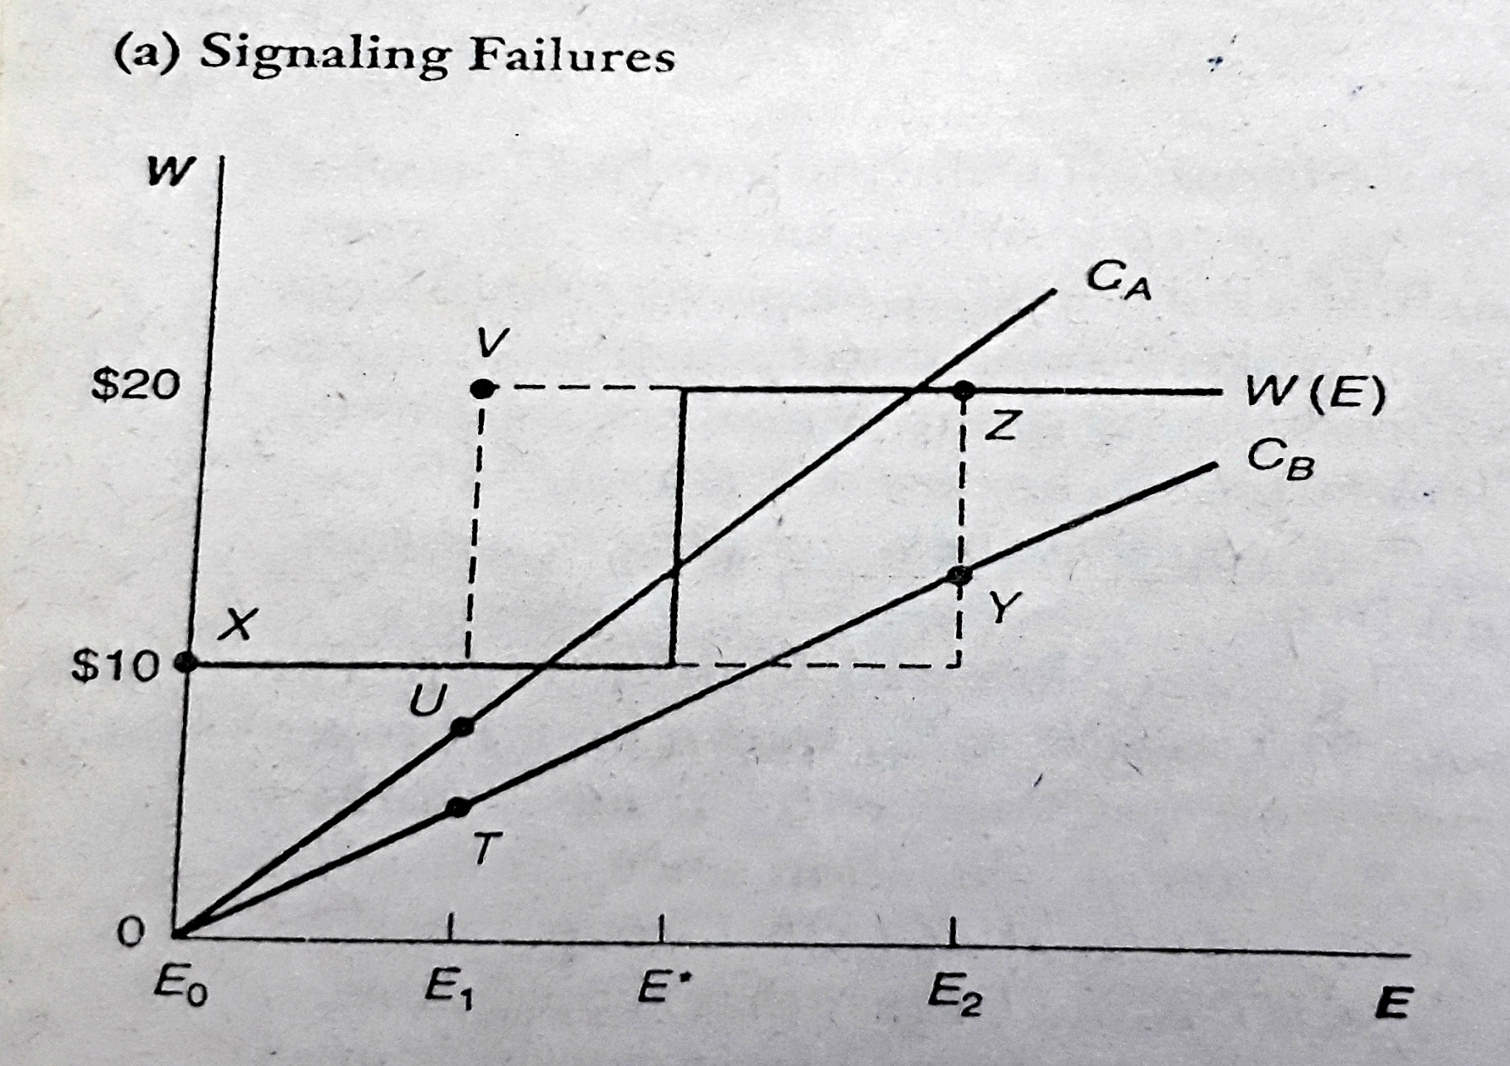

Slide 21
